Slide 1
Pass Data from Controller to View

Slide 2
There are various ways to pass data from a Controller to a View.
using ViewBag
using ViewData
using TempData
using ViewModel

Slide 3
ViewBag
1. ViewBag is also used to pass data from the controller to the respective view
2. ViewBag is a dynamic property that takes advantage of the new dynamic features in C# 4.0
3. It is also available for the current request only
4. If redirection occurs, then its value becomes null
5. Doesn't require typecasting for complex data type
we can use ViewBag to pass data from controller to view
In ActionMethod
@ViewBag.msg=“set message”;
in View
use
@ViewBag.msg // it will display data of ViewBag.msg

Slide 4
ViewData
1. ViewData is used to pass data from controller to view
2. It is derived from ViewDataDictionary class
3. It is available for the current request only
4. Requires typecasting for complex data type and checks for null values to avoid error
5. If redirection occurs, then its value becomes null
Works like ViewBag
in controller
ViewData[“name”]=“admin”;
in view
@ViewData[“name”] // it will display message from ViewData

Slide 5
TempData
1. TempData is derived from TempData Dictionary class
2. TempData is used to pass data from the current request to the next request
3. It keeps the information for the time of an HTTP Request. This means only from one page to another.
It helps to maintain the data when we move from one controller to another controller or from one action to another action
4. It requires typecasting for complex data type and checks for null values to avoid error. Generally, it is used to store only one time messages like the error messages and validation messages

Slide 6
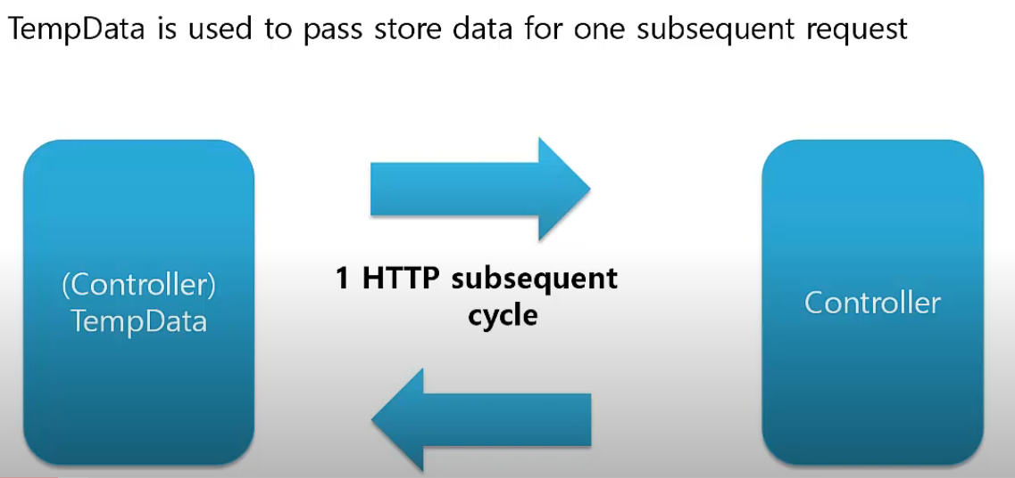

Slide 7
TempData works as a dictionary
TempData is used to store data for next subsequently request only.
We can assign any name to key
TempData internally uses session to store data
e.g.
TempData["myKey"] = Value;

Slide 8
TempData.Keep()
To save data for next HTTP call we use Keek() method.
To save data of all TempData we use Keek().
To save data for a particular key we use Keep("key").
e.g
TempData.Keep()
TempData.Keep("key")

Slide 9
Peek()
Peek) is used to get the data and save for next call.
Peek() = Get data from TempData() + Keep()
TempData - Internally it uses Session.
If session is disabled in application then TempData will not work.
(Note : use Session.Abandon() to delete session)
Point to remember

